Slide 1
Florence County School District Three
MAY 2017
BOARD FINANCIALS
&
FINAL READING
General Fund Budget
Fiscal Year 2017-2018
Laura Hickson, Ed.S.
Superintendent
Michelle B. Humphrey
Director of Finance
JUNE 15,2017

Slide 2
MAY 2017 FINANCIALS
REPORTS ARE LINKED TO THE BOARD AGENDA AND ARE ALSO POSTED ON THE FSD# 3 WEBSITE
GENERAL FUND BUDGETED
REVENUE & EXPENSES= $28,318,330.00
CONTINUING GOAL OF SAVING $500K IN GENERAL FUND EXPENDITURES

Slide 3
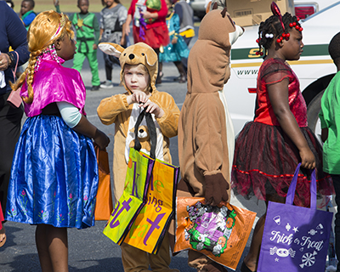
MISSION
Ensuring Our Students are College and/or Career Ready

Slide 4
2017/2018 BOARD GOALS
To ensure the safety of all district schools, offices, students, and staff.
To improve the academic success of all students.
To increase the number of students reading on grade level in grades K-3.
To recruit, retain, and train excellent instructional and administrative staff.
To build effective school, community and business relationships/partnerships.
To ensure financial stability.
4

Slide 5
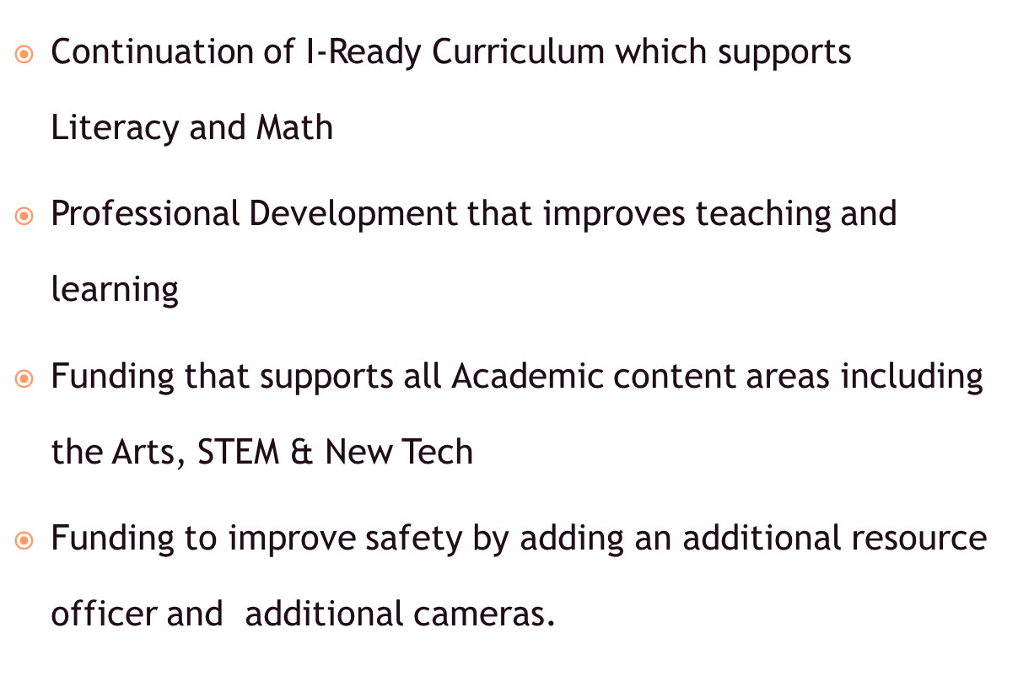
BALANCED BUDGET THAT PRIORITIZES INSTRUCTION & SAFETY

Slide 6
3 – 135 Average Daily Membership TREND
DATE ADM TREND
3/22/2011 3,391.19
3/26/2012 3,477.44 +86.25
4/01/2013 3,570.04 +92.60
3/27/2014 3,558.52 -11.52
3/23/2015 3,601.45 +42.93
3/25/2016 3,560.55 -40.90
5/03/2017 3,522.93 -37.62
6

Slide 7
FLORENCE COUNTY SCHOOL DISTRICT THREE BASIS OF BUDGET PROJECTIONS – GENERAL FUND FY 2018 PROJECTED BUDGET FINAL READING– JUNE 15,2017
Base Student cost of $2,425 has been approved by Senate. This is a $75.00/pupil increase from last year.
EFA (Education Finance Act) uses the 135th ADM for calculating district funding. ( FINAL 135 ADM used)
Allowable millage increase from SC Revenue and Fiscal Affairs Office is 1.28%= 201.65 mills. (199.10 mills 16/17)
Health Insurance –PEBA projecting a 3.3% increase employer only increase beginning January 1, 2018.
State Retirement – estimated increase for employer (.5%) Current Employer Rate = 16.89% FY 17-18 Rate with increase= 17.39%

Slide 8
Local tax calculations
 | MILLAGE FOR 17-18
 | number of mills for 16-17 |  |  |  | 199.10
 | 1.28 % CPI 0.0 % Population increase |  |  |  | 0.0128 | ( letter from SC Revenue and Fiscal Affairs)
 | cap mill increase for 17-18 |  |  |  | 2.55
 | TOTAL NUMBER OF MILLS |  |  |  | 201.65 | **
 | VALUE OF A MILL for 16-17
 | 100% value of a mill (3/16) |  |  |  | $34,531.80
 | 95% collection rate = |  |  |  | $32,805.21
 | TOTAL AD VALOREM TAXES |  |  |  | $6,615,120.16
ASSESSED VALUE OF MILL
TAX YEAR ENDING 2016
 |  | Assessment Values |  |  | Assessment
SCHOOL YEAR: 2016-2017 | Real Estate | NET HOMESTEAD |  |  | .95 Collection
 | Farm 4% | 1,895,483 |  |  | 1,800.71 | 363,110
 | Farm 6% | 73,167 |  |  | 70 | 14,016
 | Non-Farm 4% |  |  |  | -
 | Non-Farm 6% | 13,676,642 |  |  | 12,993 | 2,619,980
 | Mobile Home 4% |  |  |  | -
 | Mobile Home 6% | 515,976 |  |  | 490 | 98,843
 | Business Personal | 103,607 |  |  | 98 | 19,848
 | Watercraft | 197,511 |  |  | 188 | 37,836
 | Aircraft | 15,410 |  |  | 15 | 2,952
 | Utilities | 3,543,510 |  |  | 3,366 | 678,816
 | Tax Com Fur/Fix | 1,539,980 |  |  | 1,463 | 295,008
 | Manuf Real Estate | 2,037,705 |  |  | 1,936 | 390,355
 | Manuf Personal | 2,907,279 |  |  | 2,762 | 556,936
 | Railroad/Pipeline | 581,097 |  |  | 552 | 111,318
 | Vehicles | 7,444,430 |  |  | 7,072 | 1,426,100
 | District Total | 34,531,797 |  |  | 32,805 | 6,615,120
 |  |  |  |  |  | 4,630,834.06

Slide 9
EFA PROJECTIONS
EFA PROJECTIONS |  |  | BUDGET 2017-2018
State Base Student for FSD#3: |  |  |  |  |  |  | 135th DAY
$2,425.00 |  | PROJECTED |  |  |  | 2016-2017 | 2017-2018
86.0% | $2,085.50 | 2017-2018 |  |  | 135 | BUDGET | PROJECTED
 |  | 135 | W'GH |  | DAY | EFA | EFA
Using 135th day ADM 2016-2017 |  |  |  |  | WPU'S | ALLOCATION | 135 DAY WPU's | Difference
Kindergarten |  | 265.55 | 1.00 |  | 265.55 | $507,832.00 | $553,804.53 | $45,972.53
Primary |  | 737.20 | 1.00 |  | 737.20 | $1,561,740.00 | $1,537,430.60 | ($24,309.40)
Elementary |  | 1095.79 | 1.00 |  | 1095.79 | $2,195,016.00 | $2,285,270.05 | $90,254.04
NOTE: No projected loss of student ADM |  | (43.00) | 1.00 |  | (43.00) | $0.00 | ($89,676.50) | $(89,676.50)
Secondary |  | 310.25 | 1.00 |  | 310.25 | $421,155.00 | $647,026.38 | $225,871.38
Educable Ment H 'capped |  | 31.74 | 1.74 |  | 55.23 | $110,188.00 | $115,177.16 | $4,989.16
Learning Disabilities |  | 470.69 | 1.74 |  | 819.00 | $1,797,553.00 | $1,708,025.75 | (89,527.25)
Trainable Ment H 'capped |  | 8.12 | 2.04 |  | 16.56 | $34,590.00 | $34,545.89 | ($$44.11)
Emotionally H 'capped |  | 6.36 | 2.04 |  | 12.97 | $28,152.00 | $27,058.11 | ($1,093.89)
Orthopedically H'capped |  | 4.41 | 2.04 |  | 9.00 | $8,234.00 | $18,761.99 | $10,527.99
Visually Handicapped |  | 0.00 | 2.57 |  | 0.00 | $0.00 | $0.00 | $0.00
Hearing Handicapped |  | 2.16 | 2.57 |  | 5.55 | $44,624.00 | $11,577.03 | ($33,046.97)
Speech Handicapped |  | 139.11 | 1.90 |  | 264.31 | $559,899.00 | $551,216.42 | ($8682.58)
Homebound |  | 3.84 | 1.00 |  | 3.84 | $21,472.00 | $8,008.32 | ($13,463.68)
Vocational 1 |  | 426.47 | 1.29 |  | 550.15 | $1,332,343.00 | $$1,147,330.11 | ($185,012.89)
Vocational 2 |  | 0.00 | 1.29 |  | 0.00 | $0.00 | $0.00 | $0.00
Vocational 3 |  | 0.00 | 1.29 |  | 0.00 | $0.00 | $0.00 | $0.00
Autism |  | 21.24 | 2.57 |  | 54.59 | $119,088.00 | $113,840.77 | ($5,247.23)
EXTRA WEIGHTED:
Gifted & Talented Education Students |  | 298.42 | 0.15 |  | 44.76 | $118,966.00 | $93,353.24 | ($25,612.76)
Academic Assistance |  | 1658.21 | 0.15 |  | 248.73 | $378,089.00 | $518,729.54 | $140,640.54
Limited English Proficiency |  | 141.41 | 0.20 |  | 28.28 | $56,507.00 | $58,982.11 | $2475.11
Pupils in Poverty |  | 3,310.0 | 0.20 |  | 662.00 | $1,356,157.00 | $1,380,601.00 | $24,444.00
Dual Credit Students |  | 73.81 | 0.15 |  | 11.07 | $0.00 | $23,089.61 | $23,089.61
Total |  | 8961.78 |  |  | 5151.84 | $10,651,605.00 | $10,744,152.10 | $92,547.10
 |  |  |  | *FY 17-18 135 ADM with 43 student loss

Slide 10
2017-2018 REVENUE PROJECTIONS LOCAL
 |  |  |  | PER CENT
ACCOUNT DESCRIPTION | BUDGET | BUDGET | INCREASE/ | INCREASE/
 | 2016-2017 | 2017-2018 | (DECREASE) | (DECREASE)
PROPERTY TAXES | 4,550,000.00 | 4,630,834.06 | 80,834.06 | 1.78%
DLQT TAXES | 325,000.00 | 308,000.00 | (17,000.00) | -5.23%
VEHILCE TAXES | 1,300,000.00 | 1,426,100.09 | 126,100.09 | 9.70%
PENALTIES AND INTEREST | 10,000.00 | 10,000.00 | 0.00 | 0.00%
REVENUE IN LIEU OF TAXES | 560,000.00 | 558,186.00 | (1,814.00) | -0.32%
STUDENT TUITION PAYMENTS | 13,000.00 | 13,000.00 | 0.00 | 0.00%
TUITION PAYMENT FROM OTHER | 10,000.00 | 10,000.00 | 0.00 | 0.00%
INTEREST ON INVESTMENTS | 1,200.00 | 1,500.00 | 300.00 | 25.00%
INTEREST ON SCLGIP | 1,000.00 | 0.00 | (1,000.00) | -100.00%
INTEREST ON CHECKING | 800.00 | 0.00 | (800.00) | -100.00%
RENTAL OF PROPERTY | 35,000.00 | 12,000.00 | (23,000.00) | -65.71%
DONATIONS- PRIVATE SOURCES | 200,000.00 | 5,000.00 | (195,000.00) | -97.50%
MISCELLANEOUS REVENUE | 5,000.00 | 5,000.00 | 0.00 | 0.00%
MISC/ ERATE REFUNDS | 75,000.00 | 75,000.00 | 0.00 | 0.00%
TRANSCRIPTS | 2,000.00 | 1,000.00 | (1,000.00) | -50.00%
 | $ -------------- | $ -------------- | $ ----------------
LOCAL REVENUE | 7,088,000.00 | 7,055,620.16 | (32,379.84) | -0.46%

Slide 11
2017-2018 REVENUE PROJECTIONS STATE
 |  |  |  | PER CENT
ACCOUNT DESCRIPTION | BUDGET | BUDGET | INCREASE/ | INCREASE/
 | 2016-2017 | 2017-2018 | (DECREASE) | (DECREASE)
SCHOOL BUS DRIVER SALARY | 261,856.00 | 197,033.26 | (64,822.74) | -24.76%
TRANSPORTATION WORKERS COM | 13,160.00 | 13,233.65 | 73.55 | 0.56%
EMPLOYEE FRINGE | 4,496,922.00 | 4,647,056.00 | 150,134.00 | 3.34%
PEBA ALLOCATION CREDIT | 0.00 | 221,656.39 | 221,656.39
RETIREE INSURANCE | 791,608.00 | 872,002.00 | 80,394.00 | 10.16%
KINDERGARTEN | 507,832.00 | 553,804.53 | 45,972.53 | 9.05%
PRIMARY | 1,561,740.00 | 1,537,430.60 | (24,309.40) | -1.56%
ELEMENTARY | 2,195,016.00 | 2,285,270.05 | 90,254.04 | 4.11%
HIGH SCHOOL | 421,155.00 | 557,349.88 | 136,194.88 | 32.34%
TMH | 34,590.00 | 34,545.89 | (44.11) | -.013%
SPEECH HANDICAPPED | 559,899.00 | 551,216.42 | (8,682.58) | -1.55%
HOMEBOUND REVENUE | 21,472.00 | 8,008.32 | (13,463.68) | -62.70%
EMOTIONALLY HANDICAPPED | 28,152.00 | 27,058.11 | (1,093.89) | -3.89%
EDUCABLE MENTALLY | 110,188.00 | 115,177.16 | 4,989.16 | 4.53%
LEARNING DISABILITIES | 1,797,553.00 | 1,708,025.75 | (89,527.25) | --4.98%
HEARING HANDICAPPED | 44,624.00 | 11,577.03 | (33,046.97) | -74.06%
ORTHOPEDICALLY HANDICAPPED | 8,234.00 | 18,761.99 | 10,527.99 | 127.86%
VOCATIONAL | 1,332,343.00 | 1,147,330.11 | (185,012.89) | -13.89%
AUTISM | 119,088.00 | 113,840.77 | (5,247.23) | -4.41%
HIGH ACHIEVING STUDENTS | 118,966.00 | 93,353.24 | (25,612.76) | -21.53%
ESOL/ESL | 56,507.00 | 58,982.11 | 2,475.11 | 4.38%
ACADEMIC ASSISTANCE | 378,089.00 | 518,729.54 | 140,640.54 | -37.20%
POVERTY | 1,356,157.00 | 1,380,601.00 | 24,444.00 | 1.80%
DUAL | 0.00 | 23,089.61 | 23,089.61
PROPERTY TAX RELIEF (TIER I) | 802,083.00 | 802,083.00 | 0.00 | 0.00%
HOMESTEAD TAX EXMPT ( TIERII) | 429,027.00 | 429,027.00 | 0.00 | 0.00%
REIMB FOR PROPERTY TAX RELIEF (TIER III) | 1,830,613.00 | 1,925,252.00 | 94,639.00 | 5.17%
MERCHANT'S INVENTORY | 94,239.00 | 94,239.00 | 0.00 | 0.00%
MANUFACTURER'S DEPRC | 770,000.00 | 770,000.00 | 0.00 | 0.00%
OTHER STATE | 30,000.00 | 30,000.00 | 0.00 | 0.00%
MAINT & OPER- LOW INCOME | 10,000.00 | 10,000.00 | 0.00 | 0.00%
 | $ -------------- | $ -------------- | $ -----------------
TOTAL STATE REVENUE | 20,181,113.00 | 20,755,734.20 | 574,621.30 | 2.85%%

Slide 12
TRANSFERS FROM OTHER FUNDS
 |  |  |  | PER CENT
ACCOUNT DESCRIPTION | BUDGET | BUDGET | INCREASE/ | INCREASE/
 | 2016-2017 | 2017-2018 | (DECREASE) | (DECREASE)
TRANSFER FROM EIA | $799,217.00 |  | (799,217.00) | -100.00%
IND COST FROM OTHER FUND | $250,000.00 | $0.00 | (250,000.00) | -100.00%
FOOD SERVICE EXCESS FRINGE |  | $173,000.00 | 173,000.00 | 100.00%
TRANSFER FROM EIA FUND 350 |  | $685,330.00 | 685,330.00 | 100.00%
TRANSFER FROM EIA FUND 355 |  | $104,583.00 | 104,583.00 | 100.00%
INDIRECT COST FUND 201 |  | $108,648.00 | 108,648.00 | 100.00%
INDIRECT COST FUND 203 |  | $69,800.00 | 69,800.00 | 100.00%
INDIRECT COST FUND 205 |  |  | 0.00 | 100.00%
INDIRECT COST FUND 207 |  |  | 0.00 | 100.00%
INDIRECT COST FUND 221 |  |  | 0.00 | 100.00%
INIDRECT COST FUND 224 |  | $6,920.00 | 6,920.00 | 100.00%
INDIRECT COST FUND 237 |  |  | 0.00 | 100.00%
INDIRECT COST FUND 243 |  | $3,494.53 | 3,494.53 | 100.00%
INDIRECT COST FUND 264 |  | 0.00 | 0.00 | 100.00%
INDIRECT COST FUND 267 |  | 19,061.60 | 19,061.60 | 100.00%
INDIRECT COST FS |  | 68,000.00 | 68,000.00 | 100.00%
TRANSFER FROM FUND 825 |  | 50,000 | 50,0000 | 100.00%
TRANSFER FROM AFTERSCHOOL PROGRAM |  | 50,000 | 50,0000 | 100.00%
 | $1,049,217.00 | $1,338,837.13 | $289,620.13 | 27.60%
TOTAL REVENUE | $ 28,313,330.00 | $29,150,191.59 | $831,861.59 | 2.94%

Slide 13
FSD#3 GENERAL FUND BUDGET FY 17-18 EXPENDITURES
REVENUE:
 |  | BOARD APPROVED REVENUE 16-17 YEAR |  |  | $28,318,330.00
 |  |  | FY 17-18 SENATE VERSION REVENUES |  | $831,861.59
 |  |  |  |  |  | $29,150,191.59
EXPENDITURES:
 |  | BOARD APPROVED EXPENSES 16-17 YEAR |  |  | $28,318,330.00
 |  | REQUEST FOR EXPENDITURE CHANGES:
 |  | 1 | DECREASE POSTIONS (Attrition) |  | ($476,987.37)
 |  | 2 | INS INCREASE 3.3% ( 6 months) |  | $37,592.74
 |  | 3 | RETIREMENT increase .5% |  | $91,707.89
 |  | 5. | CERTIFICATIONS 17-18/ RESOURCE OFFICER/REORGANIZATON OF FINANCE DEPT. |  | $185,005.00
 |  | 6 | COMPUTER/ TECH EXPENSES/ARTS |  | $117,543.33
 |  | 7 | MAINT / UTILITY / REPAIR/ CURRICULUM |  | $77,000.00
 |  | 8 | RETIRED DEBT |  | $700,000.
 |  | 9. | STEP INC- Non Certified |  | $100,000.
 |  |  | TOTAL OF REQUEST: |  |  | $831,861.59
 |  | PROJECTED EXPENDITURES FY 17-18 |  |  |  | $29,150,191.59
FY 2017-18 BALANCED BUDGET |  |  |  |  |  | $0.00

Slide 14
Timeline for 2017-2018 Budget Approval
Thursday, March 16, 2017 1st Reading of 2017-2018 Proposed Budget
Tuesday, April 18, 2017 1st Public Hearing
Tuesday, May 16, 2017 2nd Public Hearing
Thursday, May 18, 2017 2nd Reading of 2017-2018 Budget
@ May Board Meeting
Thursday, June15, 2017 FINAL Reading of 2017-2018 Budget
@ June Board Meeting
Any changes that may occur at the State Level , affecting the FY 17-18 GENERAL FUND BUDGET, will be discussed at the July Board Meeting.

